Slide 1
Do now
Clarence and his friends have always been way more interested in girls than in graduating, so they decide to spend all of their time and focus on trying to date as many girls as possible. They start to wonder if there is anything they can change about themselves to make it more likely that a lady would say yes to their date requests. After some careful consideration, Clarence and the group came to the conclusion that the type of clothes they wear will make a big difference. So, half of the group spends the month wearing their normal ‘greaser’ clothes and asking out one girl a day. The other half of the group spends the month wearing goth apparel and asking out one girl a day. At the conclusion of the experiment, a tally is made of how many girls accepted the requests of each group.
Identify IV and DV
List 3 possible extraneous variables
Identify the experimental and control group
Write a hypothesis for this study
Reminders:
Phones away
Bags on floor
Books out
Pens out
Whiteboard
Reminders
Assessment: Test on Friday

Slide 2
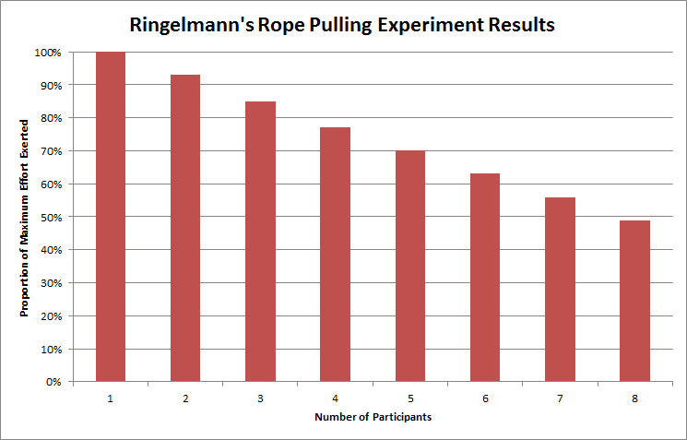
DO NOW
Describe one trend in the data
Identify two findings from the results above
Outline a conclusion for this study

Slide 3
Developmental Psychology
Syllabus points for the test:
- Erikson's theory of identity formation
Resilience and self-control
Twin and adoption studies – concordance rates
Longitudinal and cross-sectional research

Slide 4

Learning Intention
By the end of the lesson I will be able to:
Explain how adoption studies work
Evaluate twin and adoption studies
Define resliance and explain how children / teens can build it
Everyone
Completed the independent and dependent variable activities
Completed the lego game activity

Slide 5
Research: resilience
Find out:
Define resilience
Explain what are some behaviours of resilient people
How does on-going stress impact a child's brain and development
How can resilience be built in children?
Concept Development
Question 2: https://thinkgrowth.org/the-8-behaviors-of-resilient-people-a3d1acdeb8f1
Question 3: https://developingchild.harvard.edu/science/key-concepts/toxic-stress/
Question 4: https://www.apa.org/topics/resilience/guide-parents-teachers

Slide 6

Self-regulation
The ability to understand and manage your behaviour and your reactions to feelings and things happening around you.
Concept Development
Outline the:
Aim, method, findings and conclusions of this study.
What were the long-term consequences of learning delayed gratification early
How did the teacher try to teach self-control?
Notes:
https://youtu.be/BLtQaRrDsC4

Slide 7
Test questions - Erikson
Outline Erikson's stage theory of identity development
Define what Erikson mean by psychosocial crisis
Describe two key features of a stage theory
Explain what dilemmas an individual in stage 7 of Erikson's theory of identity development
Identify the crisis at stage 2 and explain the types of activities the child is exploring at this stage

Slide 8
Test questions – Twin and adoption studies
Define the term nature in relation to psychological research
Define the term nurture in relation to psychological research
Describe how twins are used in research
Explain how monozygotic twins are conceived
Identify how much DNA the following share: - Monozygotic
- Dizygotic
- Siblings
6. Outline how adoption studies work
7. Describe one strength and one weakness of twin studies
8. Describe one strength and one weakness of adoption studies
9. Describe how longitudinal research works

Slide 9

Exit Ticket
Write a test style question and answer in your book and quiz a classmate to leave

